Slide 1


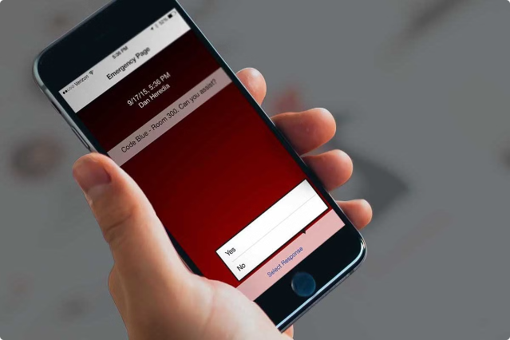
Secure Messaging Application using Database
Secure messaging applications play a crucial role in protecting sensitive communication, ensuring privacy and confidentiality.
By
Renuka.R-192210679
Pushyami Reddy-192211507
K.Tharun Teja-192210019

Slide 2

What is a Secure Messaging Application?
End-to-End Encryption
Authentication
Only the sender and recipient can read the message. It is encrypted in transit and at rest.
Verifies the identity of users to prevent impersonation and spoofing attacks.
Data Integrity
Privacy Protection
Ensures that messages are not tampered with during transmission.
Protects user data from unauthorized access and disclosure.

Slide 3
Problem Understanding & Literature Survey
Security Challenges
User Requirements
Addressing vulnerabilities like man-in-the-middle attacks, eavesdropping, and data breaches.
Understanding user needs and preferences for features like group chat, file sharing, and self-destructing messages.
Analyzing existing secure messaging solutions to identify strengths and weaknesses.
Investigating usability and accessibility aspects for diverse user groups.

Slide 4


Proposed System Design & Algorithm
1
AES Encryption
A symmetric block cipher that provides strong confidentiality for message content.
2
HTTPS Protocol
Ensures secure communication between the client and server, protecting data during transmission.
3
Diffie-Hellman Key Exchange
A public-key cryptography algorithm used to establish a shared secret key for secure communication.

Slide 5

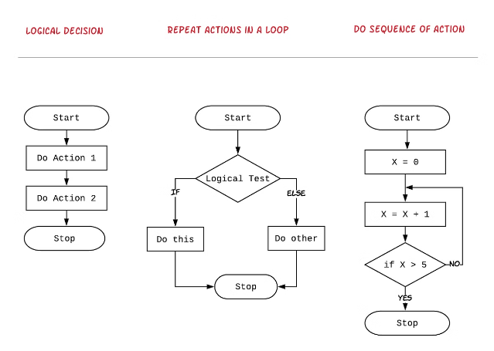
AES
Key Length
128, 192, or 256 bits
Block Size
128 bits
Modes of Operation
Electronic Codebook (ECB), Cipher Block Chaining (CBC), Counter (CTR), etc.
Strengths
High security, widespread adoption
Weaknesses
Performance overhead, susceptibility to timing attacks in some modes

Slide 6





HTTPS
TLS Handshake
Establishes a secure connection between the client and server.
Encryption
Data is encrypted using a symmetric cipher (e.g., AES).
Data Transmission
Securely transmits encrypted data between the client and server.

Slide 7


Diffie-Hellman
1
Key Generation
Each party generates a secret key and a public key.
2
Key Exchange
Parties exchange public keys, but not private keys.
3
Shared Secret Key
Both parties calculate a shared secret key based on their private key and the other party's public key.

Slide 8
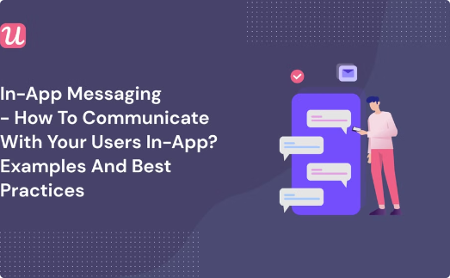
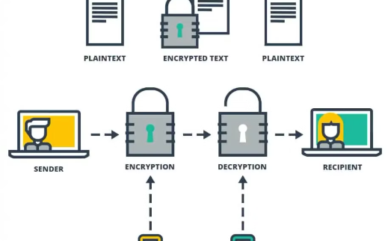
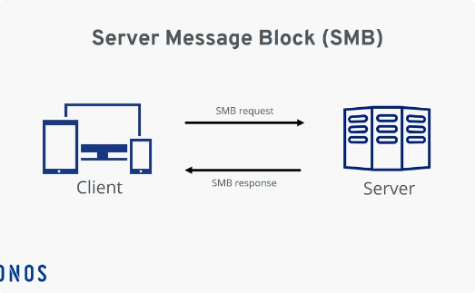
Data Flow Diagram Specifications
User Input
Encryption
Data Transmission
The user enters a message to be sent.
The message is encrypted using AES and the shared secret key.
The encrypted message is sent securely over HTTPS.

Slide 9





Implementation
Programming Language
Database
Network Communication
Platform Support
Choose a database system (e.g., MySQL, PostgreSQL) to store user data and messages.
Select a suitable programming language (e.g., Java, Python, C++) for implementing the application.
Utilize libraries or frameworks for handling HTTPS connections and data transmission.
Consider supporting multiple platforms (e.g., Android, iOS) for wider accessibility.

Slide 10

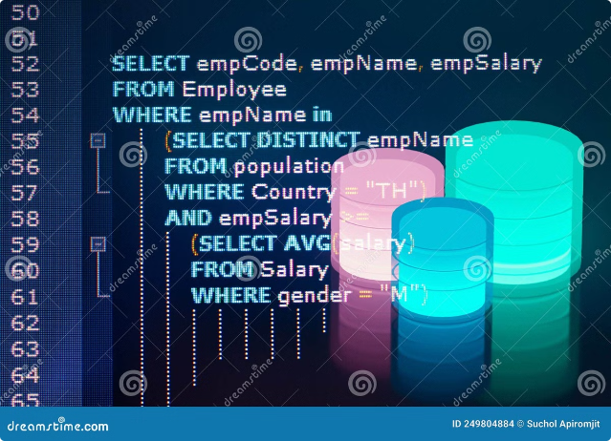
Query Handling
Implement efficient query handling mechanisms for retrieving and filtering messages based on user requests.
Optimize query performance for large datasets to ensure quick message retrieval and delivery.

Slide 11



